Slide 1

Capstone Project
Play Store App Review Analysis
By
Ashwini R
Dhanraj S
Data Science Trainee, Alma Better

Slide 2






WHY ANALYZE THE GOOGLE PLAY STORE?
Mobile App Market is set to grow 20% by 2023
Android Apps comprise 90% of the Mobile App Market
What makes an App popular? Can we predict how popular it’s going to be?
What are some interesting patterns in user behavior related to app usage & feedback?

Slide 3

Introduction
1. Android, boasting a user base of over 2.5 billion across 190 countries, holds the distinction of being the world's most widely used operating system.
2. On March 6, 2012, the introduction of Google Play marked a significant turning point in Google's digital distribution strategy, uniting the Android Market under its umbrella.
3. Presently, Android reigns as the predominant mobile operating system, powering more than 85% of all mobile devices. The Google Play Store stands as the largest and most popular repository for Android apps.
4. The Google Play Store boasts an extensive collection of over 3.04 million apps.
5. The data within Play Store apps holds the immense potential to propel businesses in the app development industry toward success.
Actionable insights can be drawn for developers to work on and capture the Android market.
The main goal of our project is:
Our project aims to collect and analyze comprehensive data about applications within the Google Play Store to offer insights into app characteristics and the prevailing status of the Android app market..
The project's aim is to investigate and examine the data to uncover the pivotal factors contributing to app engagement and achievement.

Slide 4


Problem Statement
Problem Statement
Two datasets have been supplied, one containing fundamental app details, and the other containing user reviews specific to each app.
It is imperative to thoroughly scrutinize and assess the data in both datasets to pinpoint the crucial attributes that impact app engagement and prosperity.
So, what factors inﬂuence an app's success?
An app is said to be successful if it has:
A high average user rating
A good number of positive reviews
A good number of monthly average users
High revenue per customer and so on.

Slide 5

Agenda
Introduction
Distribution of Play Store App Installs by Category
Identification of the Most Popular Apps within Each Category
Top 10 Apps in the Play Store, Analyzing All Relevant Parameters
Average Installations in Each Category
Identifying the Most Installed Apps within the Communication Category
Average App Sizes, Categorized by App Genre
Percentage of Paid Apps within Each Category
Recognition of the Top Installed Paid Apps by Category
Average User Ratings for Paid Apps
Exploring the Relationship Between User Ratings, Installations, and App Price
App Installations by Category, Considering Content Ratings
Distribution of Review Sentiments by Percentage

Slide 6
Dataset Preparation
Loading the data sets: Two datasets, First Play store app
dataset and User Reviews dataset.
Import Libraries: NumPy, Pandas, Seaborn and Matplotlib
Data cleaning: Null values, Finding and removing Outliers, Removing duplicate data.
Data Imputation: Filling the missing categorical values with mode and numerical values with median. Conversion of price, installs, reviews into numerical values.
Exploratory Data Analysis: Analyzing the data sets to summarize their main characteristics using statistical graphics and data visualizations method.

Slide 7
1.App :. In this column, you will find the app name corresponding to each data point. 2.Category: Within this column, you'll discover the category to which the app is categorized. 3.Rating : In this column, you will find the app's average rating. 4.Reviews : Within this column, you can find the count of reviews that the app has garnered on the Play Store. 5.Size : This column displays the app's storage footprint on the device. 6.Installs : In this column, you can find the total count of downloads and installations from the Play Store for the app. 7.Type : Within this column, you will find information regarding whether the app is available for free or requires payment. 8.Price: For instances where the app is a paid offering, this column furnishes information regarding its cost. 9.Content Rating: In this column, you can find the maturity rating of the app, indicating the specific age group for which it is deemed appropriate. 10.Genres: Within this column, you'll find information about the genre to which the app is affiliated. Genres can be seen as a more detailed subcategory within the broader category group. 11.Last Updated: This column holds the date when the most recent app update was made available. 12.Current Version: This column provides details about the app's present version accessible on the Play Store. 13.Android Version: This column offers information regarding the Android versions that the app is compatible with.
Attributes in Google Play store Data

Slide 8
Attributes in User reviews
App- Application name
Translated Review- User review
Sentiment- Positive/Negative/Neutral
Sentiment Polarity- Sentiment polarity score
Sentiment Subjectivity- Sentiment subjectivity score

Slide 9



OVERVIEW OF ANALYSIS
Data Cleaning
Data Exploration
Predictive Modeling
Understand the structure of the dataset and clean data before analysis
Uncover initial patterns, characteristics, and points of interest using visual exploration
Formulate a statistical model to forecast an outcome using relevant predictors

Slide 10
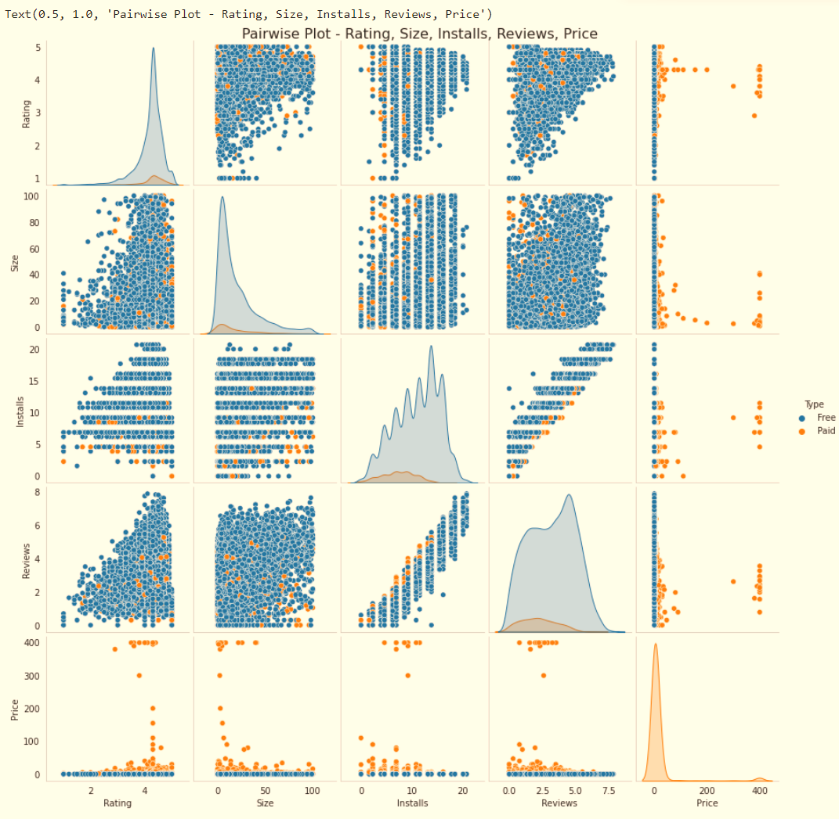
Pairwise Plot- Ratings, Size, Installs, Reviews, Price

Slide 11
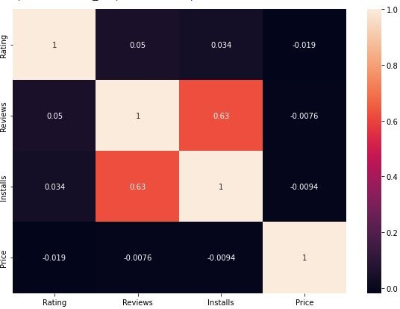
Correlation Heatmap
✔ A robust positive correlation exists between the number of reviews and the installations.
✔ The Price exhibits a minor negative correlation with the Rating, Reviews, and Installs.
✔ The Rating demonstrates a modest positive correlation with the Installs and Reviews.

Slide 12
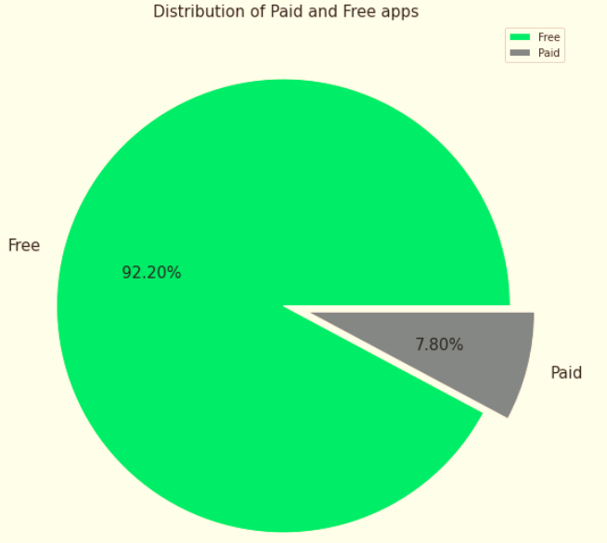

Percentage of Paid apps v/s Free apps
Our findings indicate that 92.20% of apps within the Play Store are offered at no cost, with a mere 7.80% being paid applications.

Slide 13
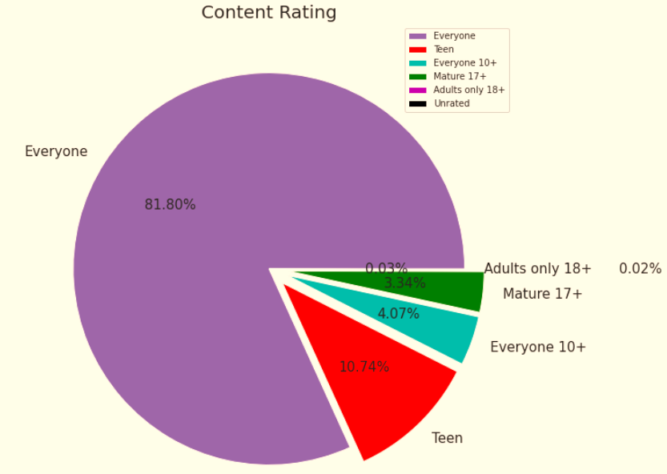
Content Rating
Based on the provided plot, it's evident that the "Everyone" category has the largest count of apps.
The Play Store hosts a significant majority of apps (81.80%) that are accessible to users of all age groups, while the remaining apps come with varying age restrictions.

Slide 14
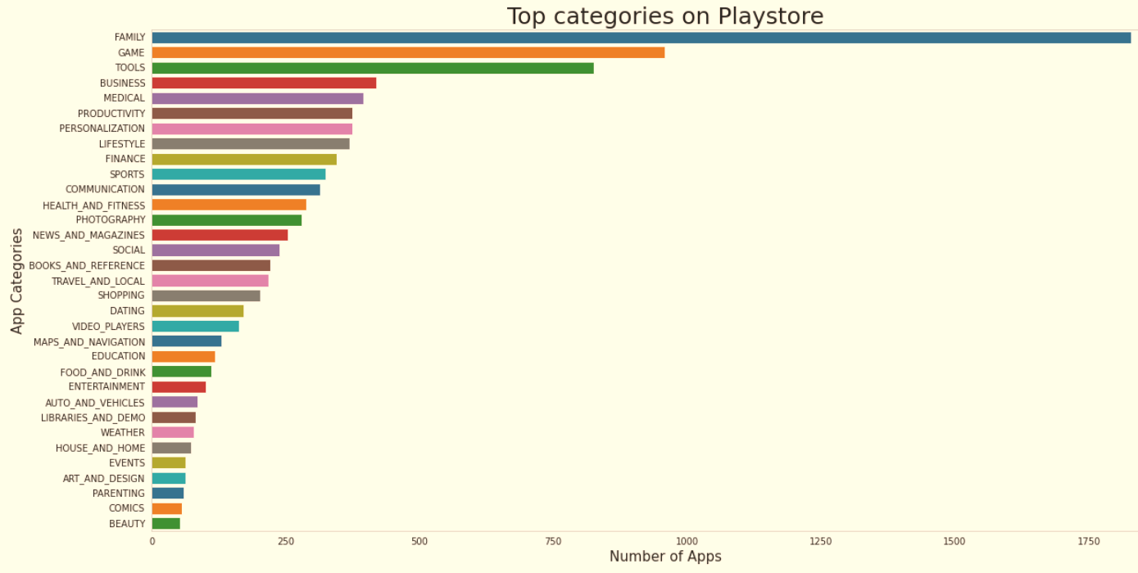
Count of Applications in each category
Family and Game apps have the
highest market prevalence. Surprising Tools, Business and Medical apps are also at the Top Count of applications.

Slide 15
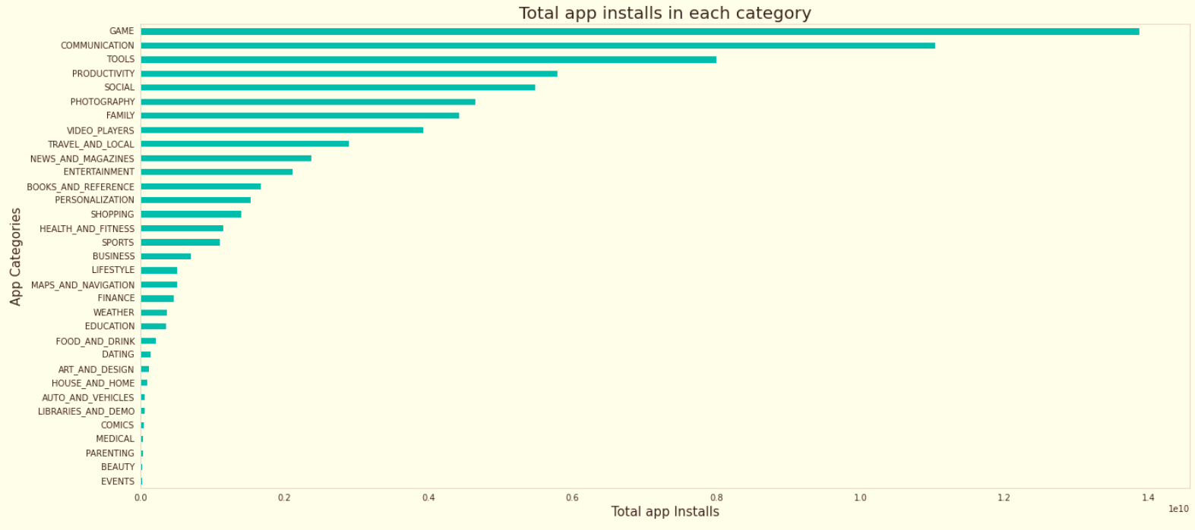
Category App's have most number of installs
Among the different app categories, the Game, Communication, and Tools categories boast the highest number of installations.

Slide 16
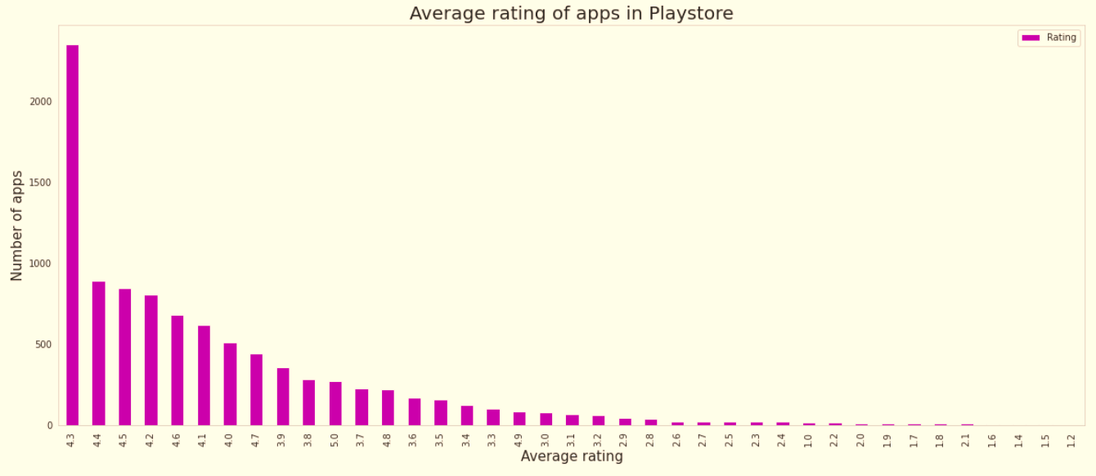
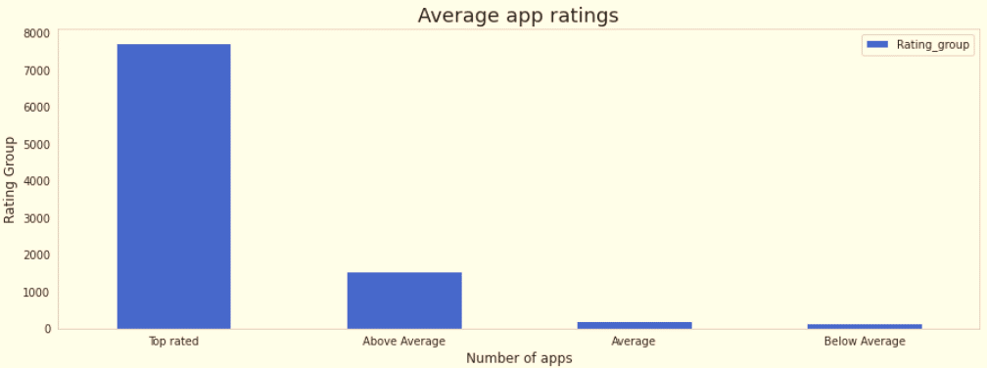
Average rating of the apps
The average user rating is divided into 4 categories:
Rating: 4-5 ⇒ Top Rated
Rating: 3-4 ⇒ Above Average
Rating: 2-3 ⇒ Average
Rating: 1-2 ⇒ Below Average
The majority of the apps in the Play Store (~80%) are top rated.
This implies that the majority of the users are happy with the services received via the respective app.

Slide 17
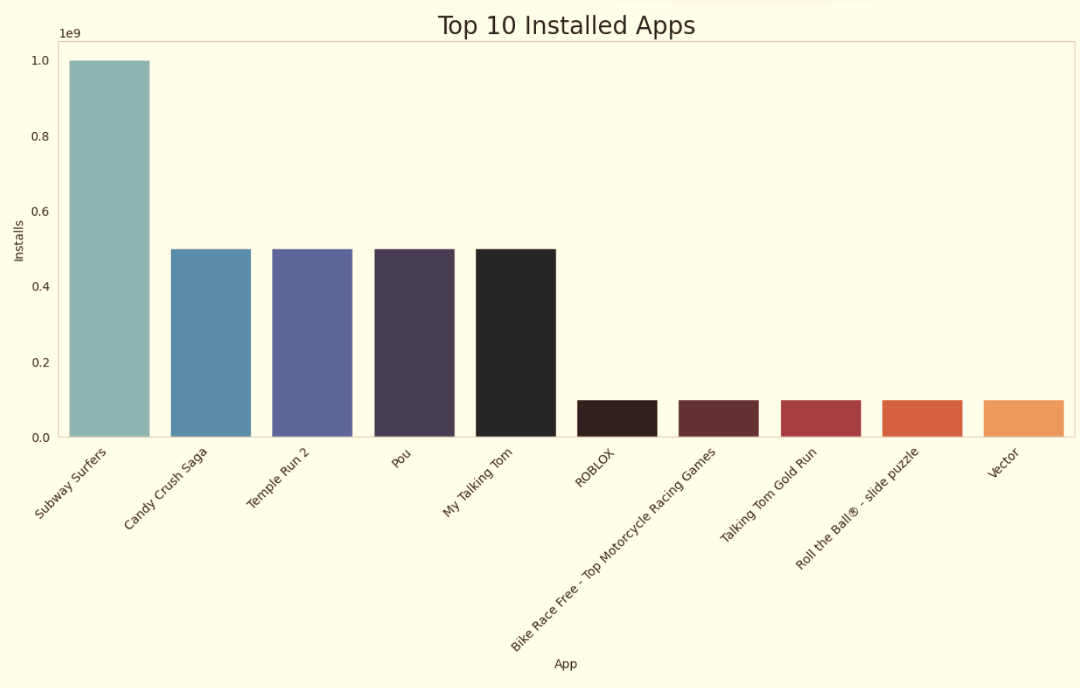
Top 10 installed apps in any category
This chart displays the most popular apps within the 'Games' category. A more in-depth exploration of the Play Store indicates that these apps are lightweight, casual, and primarily designed for single-player gaming experiences.

Slide 18
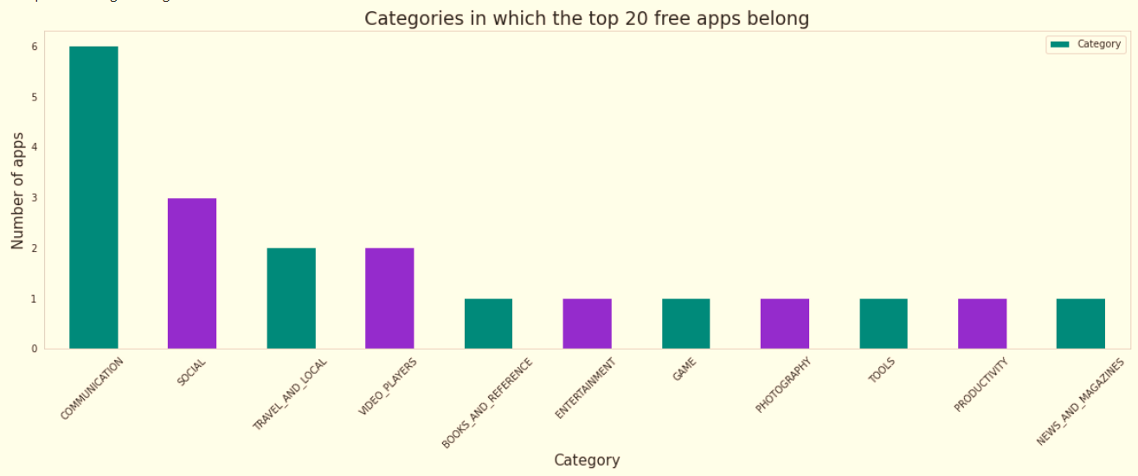
Top Free Apps
In total, there are 20 apps that are available for free and have been installed more than one billion times.
The primary categories to which these apps belong include Communication (6 apps), Social (3 apps), Video Players (2 apps), Travel and Local (2 apps).

Slide 19
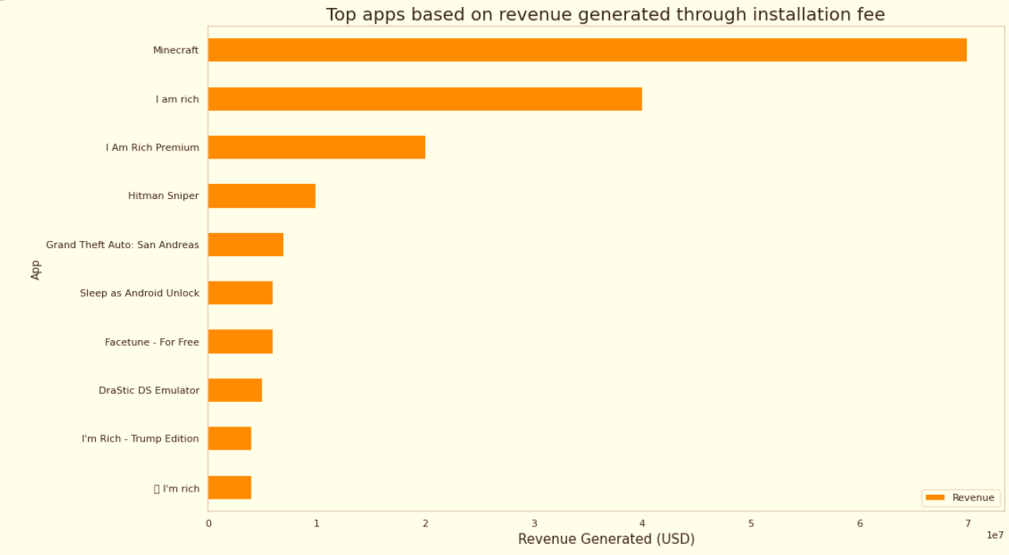
Top Paid Apps Based on Revenue Generated
The formula for calculating generated revenue is as follows:
Revenue = Installs * Price
Please note that in this context, revenue exclusively pertains to income generated through paid app installations.
The prominent categories that encompass these apps are Lifestyle (5 apps), Family (5 apps), and Games (4 apps).
Minecraft, I Am Rich, and I Am Rich Premium emerge as the leading paid apps in terms of revenue generation.
Among the apps, Minecraft is the sole application that has accumulated more than 10 million installations.

Slide 20
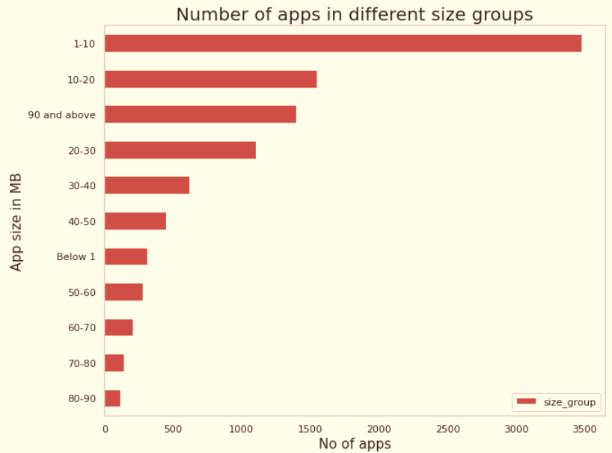
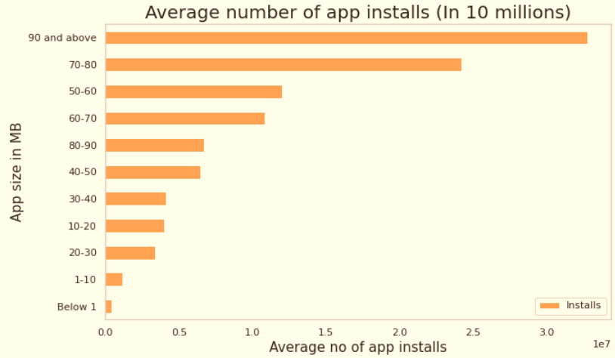
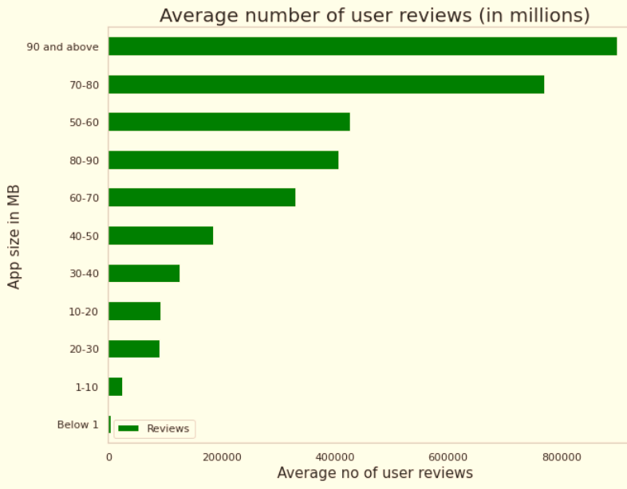
App Size Analysis
The apps are classified into size categories, ranging from approximately 0 to 100 MB, with each interval set at 10 MB.
The quantity of apps within each size category reflects the level of competition.
The mean number of user reviews and average app installations within each size category serves as an indicator of the popularity of the respective app.

Slide 21
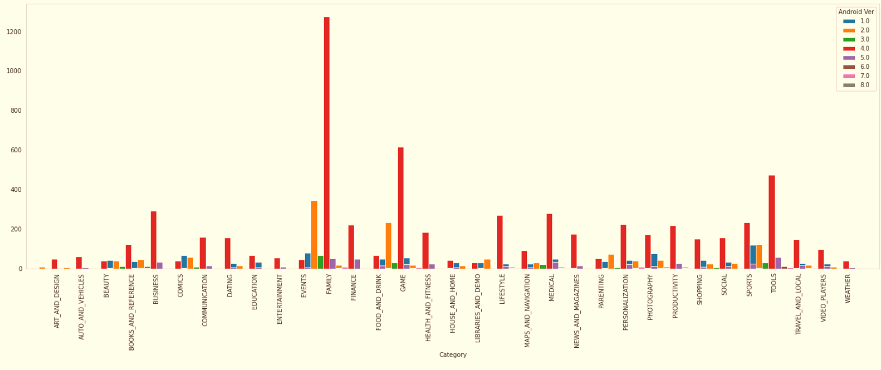
Android version based on each category

Slide 22
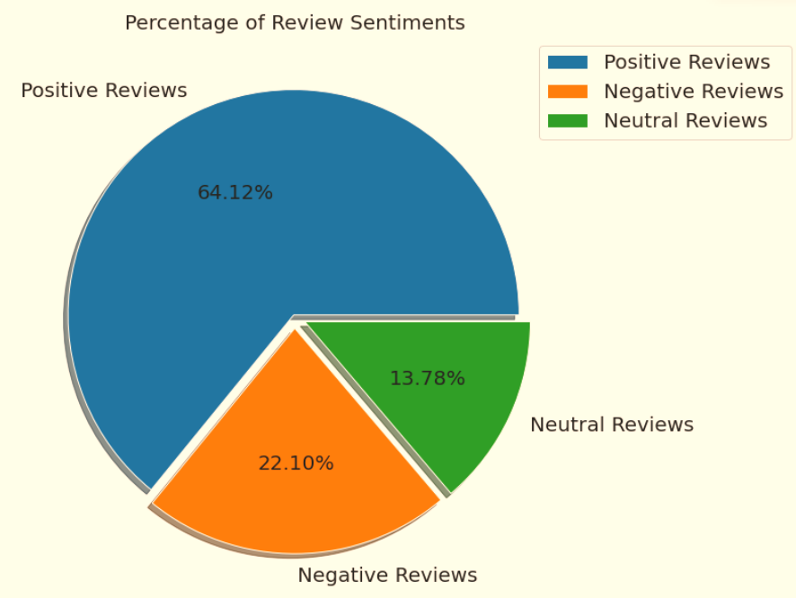
Percentage of Review Sentiments
The merged dataset, combining unique apps from the Play Store and user reviews, comprises a total of 816 entries.
In the Sentiment column, you'll find that 64% of the values are Positive, 22% are Negative, and 14% are Neutral.

Slide 23
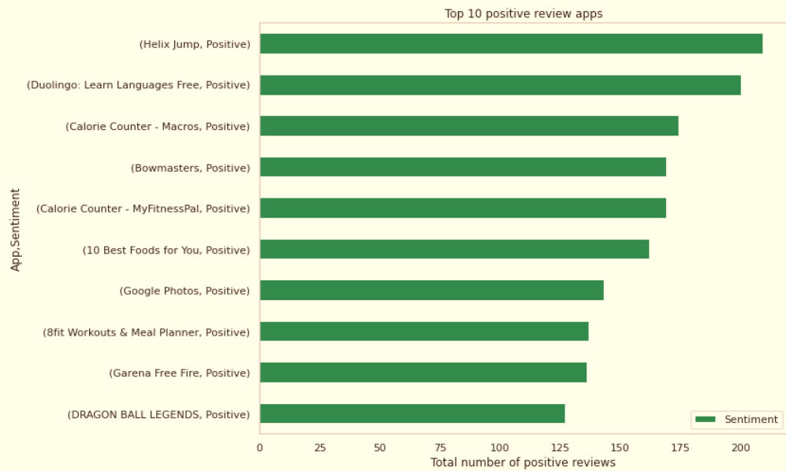
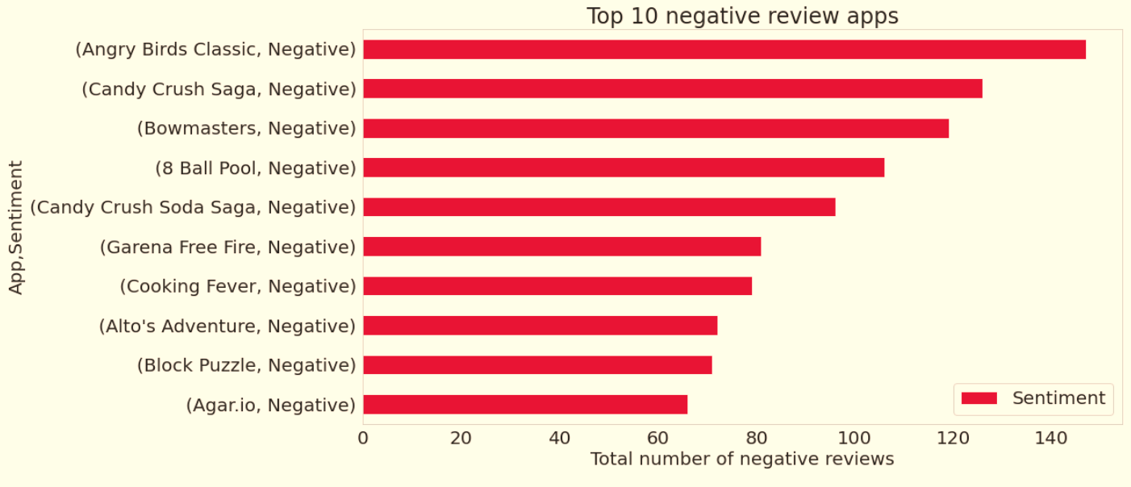
Positive and Negative Reviews
Within the merged dataset, the app "Helix Jump" holds the record for the highest number of positive sentiment counts, with a total of 209.
In the combined dataset, "Angry Birds Classic" stands out with the highest count of negative sentiments, which is 147.

Slide 24
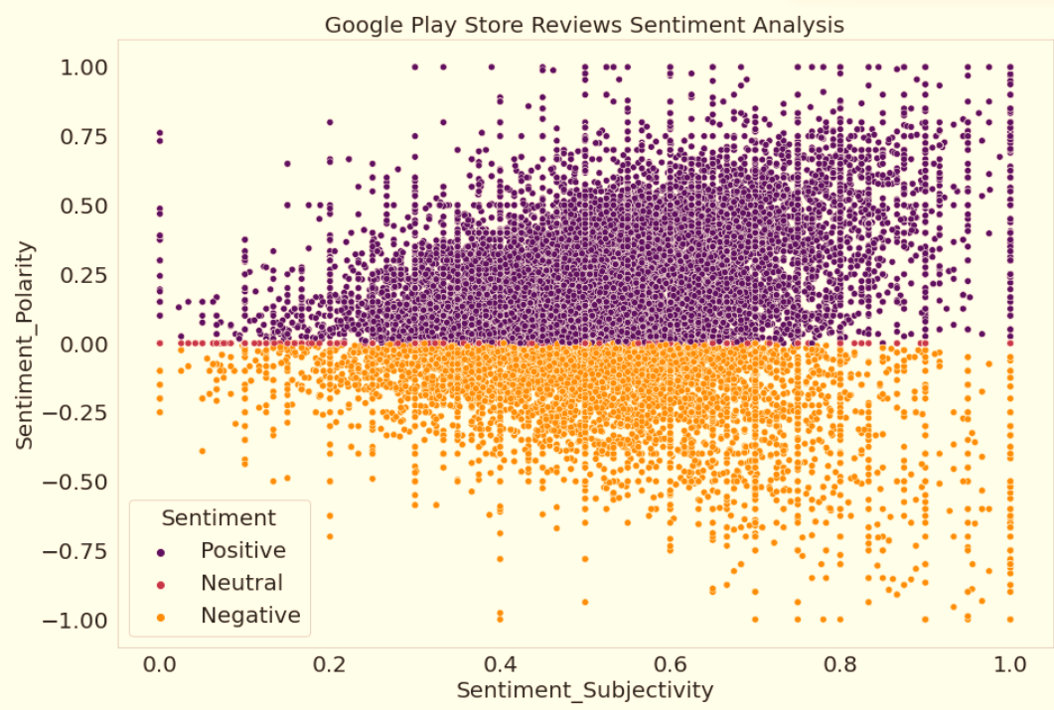
Is sentiment_subjectivity proportional to sentiment_polarity?
Based on the scatter plot above, we can draw the conclusion that sentiment subjectivity is not consistently proportional to sentiment polarity. However, in the majority of cases, it exhibits a proportional relationship, especially when subjectivity variance is either very high or very low.

Slide 25
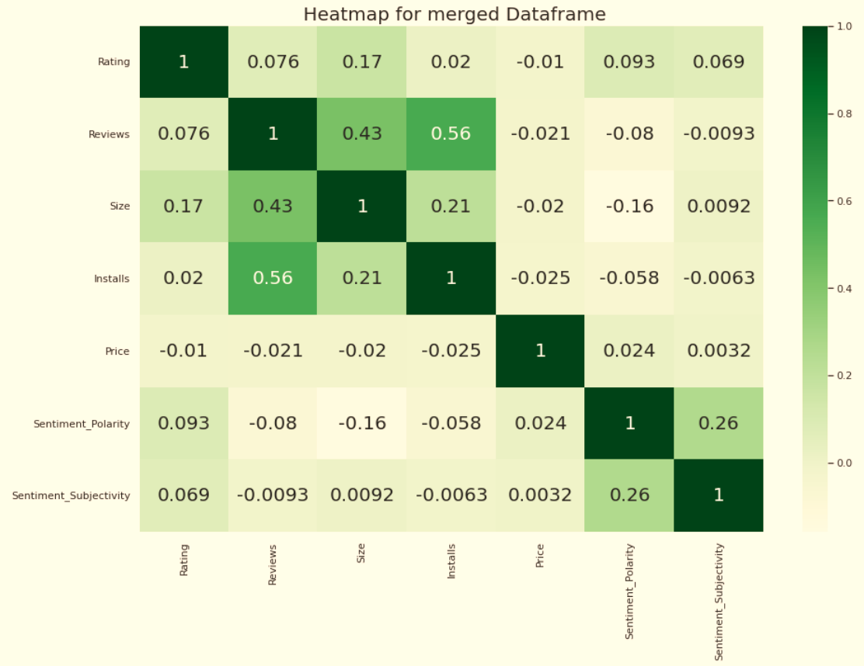
Co-Relation in merged data frame
Within this correlation matrix, no substantial correlation is observed between Rating, Reviews, Size, Installs, and Sentiment Polarity or Sentiment Subjectivity.

Slide 26
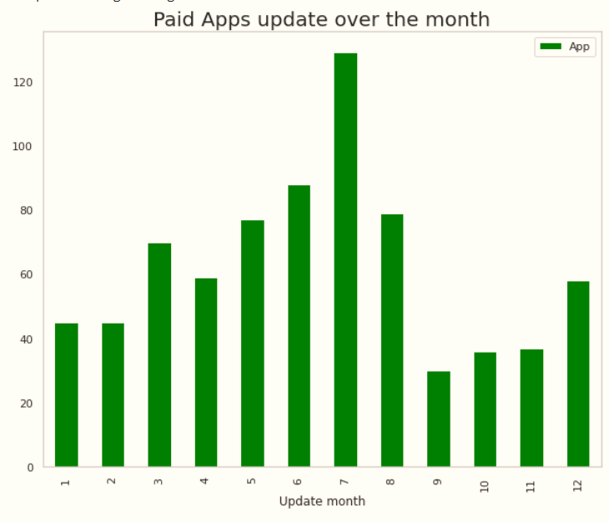
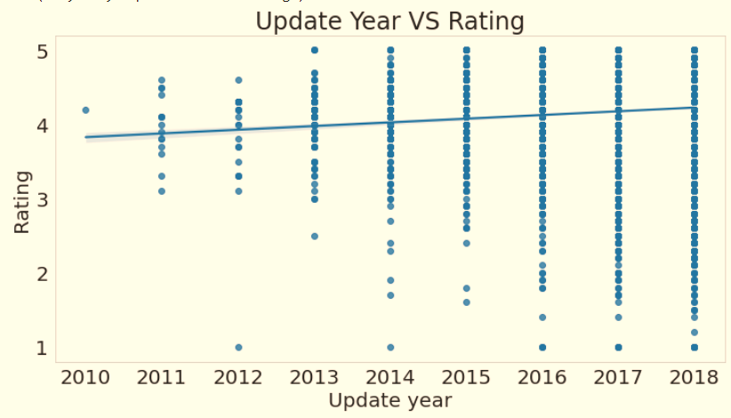
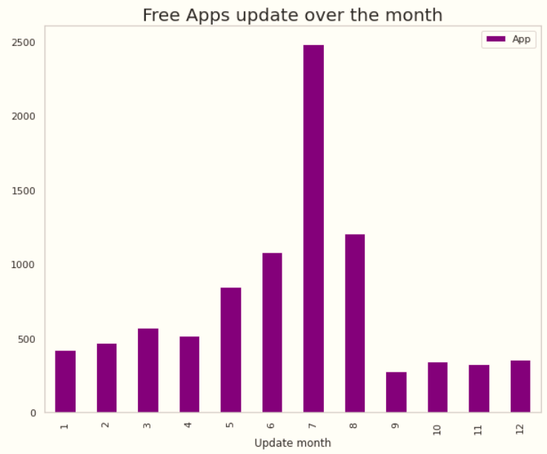
Distribution of Apps updated over the Year and Month

Slide 27

Challenges Faced
Challenges Faced
Analyzing the dataset and understanding the issue at hand.
Evaluating the key performance indicators (KPIs) for app development and formulating a solution to address the issue.
Managing errors, duplicates, and missing (NaN) values within the dataset.
Creating various visual representations to condense the dataset's information and effectively convey the findings and patterns to the audience.

Slide 28
Conclusion’s
92.19% apps are Free and 7.81% apps are paid in type.
81.80% apps have Everyone content rating.
Events category has a highest mean rating of 4.39 and Dating category has lowest 4.05 rating.
Family, Game and Tools are top three categories having 1906, 926 and 829 app count.
Most competitive category: Family
Category with the highest number of installs: Game
Tools, Entertainment, Education, Business and Medical are top Genres.
8783 Apps are having size less than or equal to 50 MB.
7749 Apps has rating more than 4.0 including both type of app.
Overall sentiment count of merged dataset in which Positive sentiment count is 64%, Negative 22% and Neutral 14%.

Slide 29
Conclusion’s
It's good to develop a Free type app and having a content rating for Everyone.
Percentage of apps that are top rated = 81.80%
There are 20 free apps that have been installed over a billion times
Minecraft is the only app in the paid category with over 10M installs, and also has produced the most revenue only from installation fee.
Price, Rating, Size has no or very less correlation with Sentiment Polarity.
The median size of the apps in the play store is 12 MB
The apps whose size varies with device has the highest number average app installs.
The apps whose size is greater than 90 MB has the highest number of average user reviews, ie, they are more popular than the rest.
Helix Jump has the highest number of positive reviews and Angry Birds Classic has the highest number of negative reviews.

Slide 30


